Slide 1
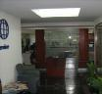
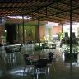
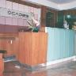
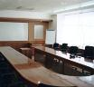

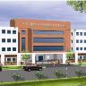
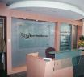

INTERIORS
ARCHITECTURE
PROJECT MANAGEMENT
ECE
ECE
EXCEL CONSTRUCTION & ELECTRICALS
COMPANY PROFILE

Slide 2
We are a young and dynamic team of Designers and Project Managers
Offering Creative, Simple and Innovative Design solutions in Architecture and Interiors. We provide effective Project Management solutions for completing the projects within the stipulated time and budget. We also provide one point turnkey solutions (Design to Execution)
We provide services that range from the inceptive stage of Feasibility Studies,
detailed Planning, Design and M&E Services , to the final stages of execution, Completion
and Occupation, using updated methodologies and Project Management Tools.
We have specialized in the Corporate (IT & ITES), Retail and Hospitality Sectors
and are capable of integrating and executing complex services systems (Electrical,
HVAC Security & Networking) with the Interiors to create State Of The Art Facilities.
In house
Designers
Vendors
(Execution)
Client
ECE
We offer Simple Solutions
to Complex Problems
Service
Consultants
ABOUT US …

Slide 3

We strive to provide the best solution in design consultancy, execution and
Project Management services maintaining
the highest standard of professionalism
and integrity.
With a commitment to quality service, we provide innovative solutions. We focus on being a customer’s delight in all our interactions through and beyond the project.
We aim to grow together with our Customers, our Shareholders and our Colleagues.
OUR MISSION

Slide 4
Our Vision is to…
Enable Transformation - Through Design Consultation, Services
integration and Project Management Support
Reduce cost of Operations - By eliminating avoidable costs and value
added design solutions.
Increase Revenue - By increasing the efficiency of design
thereby maximizing the yield.
Improve Customer - By making a difference at each customer
experience interactions thereby gaining their confidence and loyalty
Boost Productivity - By providing an empowering atmosphere to perform
Enhance Operational Agility - Through scalability, flexibility and adaptability to ever changing business environment.
OUR VISION

Slide 5
Our 4C Philosophy …
CARE - Trust and Respect for Individuals
Recognize long association with the Client
Caring for the Community at large
CUSTOMER CARE - Lending a helping care with smile
Display positive Energy in all our dealings
Enable customers to save money
Show sense of Urgency in our activities
COURAGE - Doing right thing for the association
Exhibiting your conviction with Honesty & Integrity
Taking Accountability
Intelligent Risk taking
CONTINUAL - Strive for improvement to achieve the extra ordinary
IMPROVEMENT Innovate for business excellence
Assimilate feedback
OUR 4C PHILOSOPHY

Slide 6
Preliminary Survey of the site and Master Planning including zoning.
Architectural design of the building as per the Client requirements.
(Commercial / Residential)
Interior design of the facility including space planning / color scheme
(Commercial / Retail / Hospital / Residential)
Complete Services design including Structural, Landscaping ,Electrical, HVAC, Networking, PHE and Security Systems (Sprinkler, FDA, PA, CCTV, Access Control etc…)
Project management including time and cost management of the entire project
Managing sites thru Project Managers / Site Engineers
Hold site meetings for co-ordination between the Client / Consultants & Vendors
Checking & certification of bills.
Prepare Closure Reports
Third party Auditing for Interior projects.
SERVICES RENDERED

Slide 7
To do preliminary survey of the site and design the facility accordance to the Client requirements and the industry standards/norms.
Release large scale and detailed drawings as and when required.
Site Execution including all services & Supervision by appointing Project Manager/Site Engineer and by periodic visits by Project Architects / Principal Architect to Check quality of material and workmanship and clarify any interpretation of the drawings and specifications that may be necessary.
Hold Weekly site meetings to ensure that the project proceeds generally in accordance with the agreement of the contract and sort out problems in execution.
Coordinate with Client and Consultants for smooth completion of the work and Escalate any cost and time variations to the Client
Prepare a snag list in various works and rectify them before final handing of the site.
To check and certify the running & final bills after checking the quantities.
To prepare Closure Project Reports like As-built documents
SERVICES RENDERED
Interior Design & PMC

Slide 8
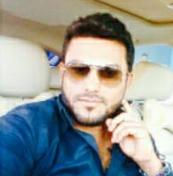
Key Personal
Mohammed Ayub Bin Khalid
Managing Director
Engineering from IIT College of Engineering Bangalore in 1995
A multi talented person in
A complete team player worked in various MNC’s sectors and has enough professional experience in managing & Handling Turnkey projects of all sizes.
*Possess sound knowledge about prevalent real estate markets with hands on experience in managing a wide range of projects including supervision, quality control & documentation of civil and interior projects.
*Proficient at developing apt design solutions for clients, providing investment & design advisory and alternatives for ensuring maximum output.
*Well versed with technical tools & systems
*Possess demonstrated communication skills with exceptional relationship management and team supervision abilities.
*Experience in designing huge projects (Both Interiors and Architecture) catering to various segments of clients (IT, ITES ,Retail etc..)
*Was part of the execution team which set up their first facility in India for some of the Global IT giants like Microsoft, CISCO, HP, Google, & SAP Labs.
*Experience in handling Turn key projects with strict monitoring of financial cash flow.

Slide 9
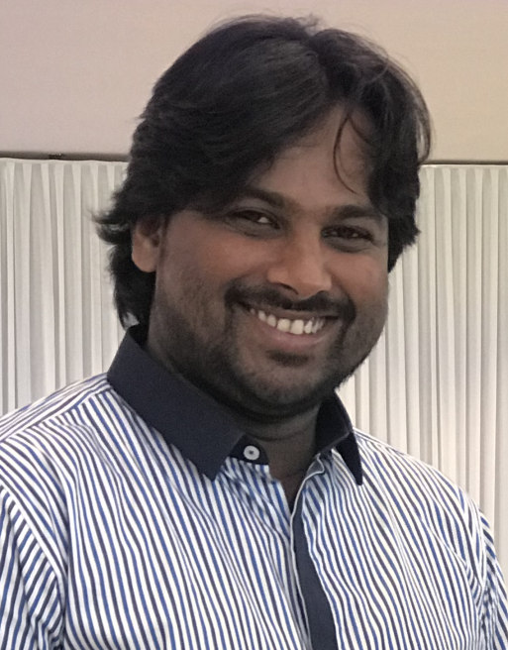
Key Personal
Irfan khan
Project Manager
Worked with various MNC’s and has enough professional experience in managing projects of all sizes.
*Possess sound knowledge about prevalent project management with hands on experience in managing a
wide range of projects including supervision, quality control & documentation of civil and interior projects.
*Experience in handling Turn key projects with strict monitoring.
*Possess in defining project scope, objectives, staffing, resources and deliverables
*Possess in planning and scheduling project timelines and milestones
*Possess in managing vendor relationships including negotiating and controlling contracts

Slide 10
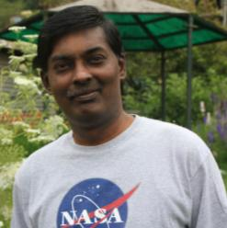
Graduated from Thiagarajar Engineering College (Autonomous), Madurai, Tamil Nadu in 1993. With all round credentials bagged the “Best Outgoing Student” award. Later went on to do MBA .
A multi talented person in Sports (Has represented Tamil Nadu in 3 Nationals / Captained MK University & was the General Captain during College days and Music (Passed 3rd grade from Royal School of Music, London).
A complete team player worked in various MNC’s like RSP Architects (Singapore), Interics (Dubai) & dwp-Interics (Singapore) and has enough professional experience in designing and managing projects of all sizes.
*Possess sound knowledge about prevalent real estate markets with hands on experience in managing a wide range of projects including supervision, quality control & documentation of civil and interior projects.
*Proficient at developing apt design solutions for clients, providing investment & design advisory and alternatives for ensuring maximum output.
*Well versed with technical tools & systems
*Possess demonstrated communication skills with exceptional relationship management and team supervision abilities.
*Experience in designing huge projects (Both Interiors and Architecture) catering to various segments of clients (IT, ITES ,Retail etc..)
*Was part of the core team of some of the prestigious infra projects like ITPL (India’s first IT Park), Infosys first building project and BIAL (One of India’s premier Greenfield Airport)
*Was part of the design team which set up their first facility in India for some of the Global IT giants like Microsoft, CISCO, HP, Google, SAP Labs & Sunmiro Systems.
*Worked with world renowned foreign designers for retail brands like TITAN Eye+, Fastrack, GAP US, Johnston & Murphy, COLE HAAN, Calvin Klein
*Experience in handling Turn key projects with strict monitoring of financial cash flow.
KEY PERSONNEL
IMMANUEL B SAMUEL
(Founder & Principal Architect)

Slide 11
STAFF STUCTURES
SL NO. | NAME | DESIGNATION
1 | Irfan Khan | Project Manager
2 | Smitha | Administrator
3 | Ravi | Accountant
4 | MD Mohsin | Project In charge
5 | MD Afnan | Site Engineer
6 | Arshiya Khanum | Receptionist
7 | Jabir Ahmed | Senior Supervisor
8 | Mohammed Sayeed | Supervisor
9 | Shamim | Office Boy
10 | Shafiq Ahmed | Material Co – Ordinate
11 | Asim | Electrical In charge
12 | Sudeesh | Electrical Supervisor

Slide 12
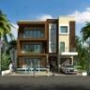
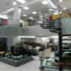
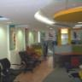

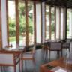
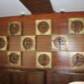
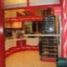
CLIENT TELE
Monarch Ergonomics
Showrooms (Around 15 stores - 5,000 Sft each TK
All across India)
TITAN Eye + (Around 350 stores - 1,500 Sft each D
All across India)
World of TITAN (Around 30 stores - 2,500 Sft each D
All across India)
MonChateu , Bangalore - 6,000 Sft TK
Ridgetop Dental Clinic
(Multi location) - 5,000 Sft each TK
Wrapz (Multi location) - 2,000 Sft each TK
Cole Haan Inc
Stores (Multi location) - 2,500 Sft each D
Johnston & Murphy
Stores (Multi location) - 2,500 Sft each D
GAP Stores
(Multi location) - 10,000 Sft each D
The Children’s Place
(Multi location) - 2,000 Sft each D
COMPLETED PROJECTS –
RETAIL/HOSPITALITY/MEDICAL
Note: D- Design; PMC – Project Management; TK – Turn key

Slide 13
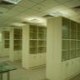
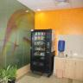
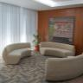
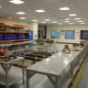
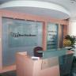
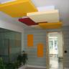
100,000 Sft
40,000 Sft
50,000 Sft
25,000 Sft
15,000 Sft
15,000 Sft
12,000 Sft
12,000 Sft
40,000 Sft
5,000 Sft
5,000 Sft
15,000 Sft
65,000 Sft
15,000 Sft
15,000 Sft
60,000 Sft
15,000 Sft
D & PMC
PMC
D & PMC
D & PMC
D & PMC
TK
TK
D & PMC
D
TK
TK
TK
D & PMC
D
D & PMC
D & PMC
TK
Cambridge Integrated Services, Bangalore -
Ascendum Solutions India Pvt Ltd, Bangalore -
AON Specialist Services Pvt Ltd, Bangalore -
Aptara Learning Pvt Ltd, Trivandrum -
TATA ELXSI, Trivandrum -
MTU Detroit Diesel India Pvt Ltd, Bangalore -
WPA World Class Services Pvt Ltd, Bangalore -
CADES, Bangalore -
GE India Pvt Ltd, Bangalore -
Takii Seeds India Pvt Ltd, Bangalore -
Semillus Fito India Pvt Ltd, Bangalore -
EION Telecom Pvt Ltd, Bangalore -
Cognizant Technology Solutions , Hyderabad -
Xchanging Technology Services India Pvt Ltd, Solan -
Xchanging Technology Services India Pvt Ltd, Shimoga -
TITAN Industries Ltd , Bangalore -
GrayMatter Software Services Pvt Ltd, Bangalore -
COMPLETED PROJECTS –
CORPORATE OFFICES
Note: D- Design; PMC – Project Management; TK – Turn key

Slide 14
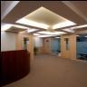
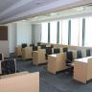
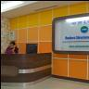
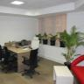
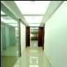
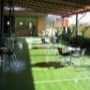
Xchanging Technology Services India Pvt Ltd, Chennai -
Tellabs India Pvt Ltd, Bangalore -
Digicaptions India Pvt Ltd , Bangalore -
Flipkart, Kolkota -
Arvin Meritor LVS India, Bangalore -
Cordys Software India Pvt Ltd, Coimbatore -
Hyder Consultants -
Flipkart, Bangalore -
Hinduja Global Solutions, Chennai -
Klauz Specialities, Bangalore -
Sooktha Consulting Pvt Ltd, Bangalore -
CareerNet Technologies Pvt Ltd, Bangalore -
3M India, Bangalore -
Karle Incubation Center, Karle Infra, Bangalore -
Karvy Stock Brocking Ltd, Mangalore -
40,000 Sft
10,000 Sft
30,000 Sft
10,000 Sft
18,000 Sft
16,000 Sft
15,000 Sft
15,000 Sft
10,000 Sft
10,000 Sft
7,500 Sft
120,000 Sft
5,000 Sft
15,000 Sft
10,000 Sft
D & PMC
TK
PMC
D
D & PMC
D & PMC
D
D
TK
TK
TK
D
TK
D & PMC
PMC
COMPLETED PROJECTS –
CORPORATE OFFICES
Note: D- Design; PMC – Project Management; TK – Turn key

Slide 15
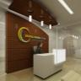
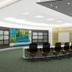
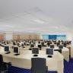
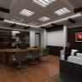
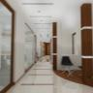
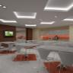
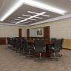
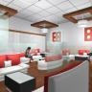
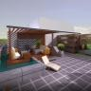
CISCO India Private Limited - 3500 Sft
VM Ware PVT LTD - 2500 Sft
Unisys Global - 2500 Sft
Genworks Health Pvt Ltd, Bangalore - 10000 Sft
CSC-Xchanging, Shimoga - 30000 Sft
Cole Haan Stores (Multi location) - 2,500 Sft
The Children’s PlaceStores
(Multi location) - 2,000 Sft
GAP Stores (Multi location) - 10,000 Sft
Monarch Ergonomics, Cochin - 5,000 Sft
Jisha Trends - 8,000 Sft
Tata Consultancy ITPL Bangalore - 16000 Sft
Dunzo Digital Pvt Ltd Bangalore (Indiranagar) - 10,000 Sft
Dunzo Digital Pvt Ltd Bangalore (Murugesh Palya) - 25,000 Sft
COMPLETED PROJECTS
CORPORATE OFFICES

Slide 16
Dunzo Xpress Mart Bangalore
Frazer town - 1950 Sft
HRBR Layout - 2400 Sft
Indiranagar - 2900 Sft
CV Ramannagar - 1800 Sft
Brookfield - 2600 Sft
Kadubesanahalli - 2200 Sft
Belandur - 2100 Sft
Sarjapura - 2000 Sft
Begur - 3600 Sft
Electronicity - 3300 Sft
BTM Layout - 1800 Sft
Jaynagar - 1700 Sft
JP Nagar - 1800 Sft
Rajajinagar - 2100 Sft
Nelasandra - 1900 Sft
Hebbal - 2300 Sft
Nagarbhavi - 2200 Sft
Yelanka - 3200 Sft
Dunzo Xpress Mart Chennai
Nanganallur - 1900 Sft
Mogappair - 2200 Sft
Guindy Estate - 2600 Sft
Virugambakkam - 2800 Sft
Perungudi - 3400 Sft
Karrapakam - 3200 Sft
Nanmangalam - 1800 Sft
Perambur - 2600 Sft
Porur - 3200 Sft
COMPLETED PROJECTS
STORES / MARTS

Slide 17
Dunzo Xpress Mart Pune
Magarpatta - 3500 Sft
Aundh - 3400 Sft
Vimannagar - 3500 Sft
Kharadi - 3600 Sft
Wanowire - 3200 Sft
Pimple Saudagar - 2800 Sft
Kothrud - 2900 Sft
Shivajinagar - 2400 Sft
Nigdi - 2800 Sft
Dhanori - 2900 Sft
Baner - 2500 Sft
Dunzo Xpress Mart Hydrabad
Banjara Hills - 3500 Sft
COMPLETED PROJECTS
STORES / MARTS

Slide 19





























CLIENT LIST

Slide 20
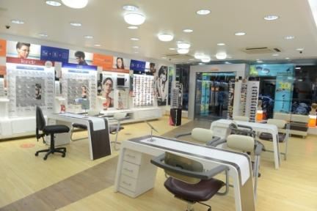
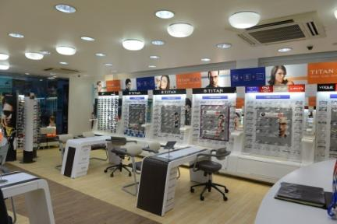
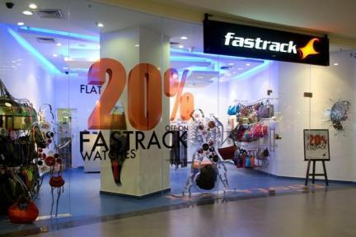
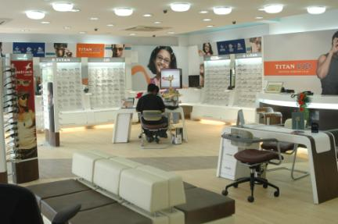

PROJECTS AT A GLANCE
TITAN Eye+
(Multi location)

Slide 21
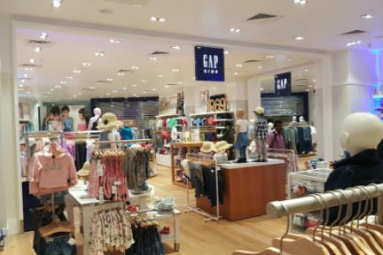
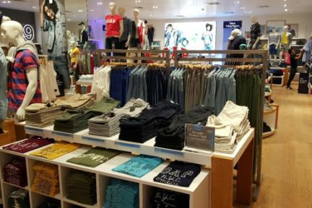
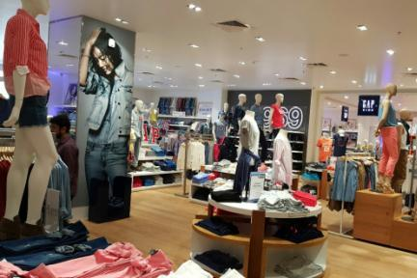
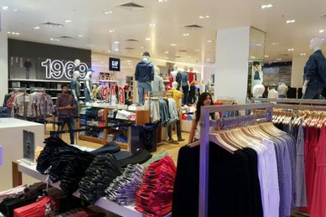

PROJECTS AT A GLANCE
GAP
(Retail Stores - Multi location)

Slide 22
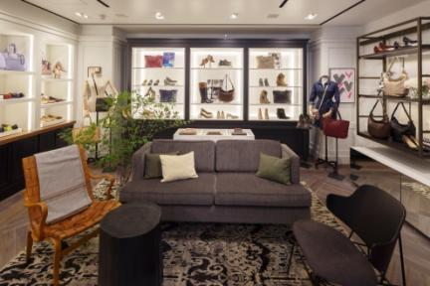
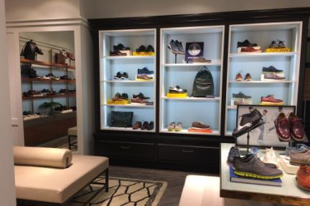
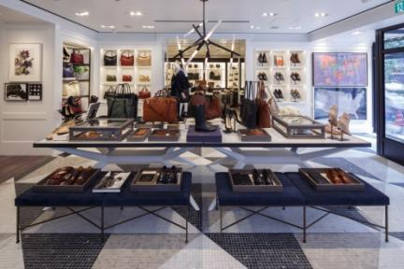
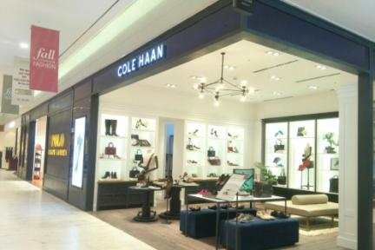

PROJECTS AT A GLANCE
Cole Haan International
(Retail Stores - Multi location)

Slide 23
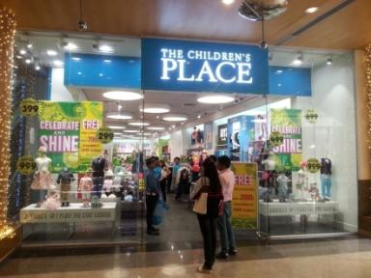
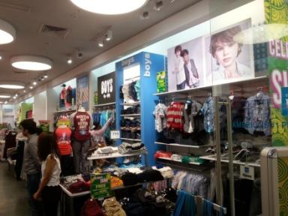


PROJECTS AT A GLANCE
The Children’s Place
(Retail Stores - Multi location)

Slide 24





PROJECTS AT A GLANCE
Johnston & Murphy
(Retail Stores - Multi location)

Slide 25





PROJECTS AT A GLANCE
Karle Incubation Center
Bangalore

Slide 26





PROJECTS AT A GLANCE
Genworks
Bangalore

Slide 27




PROJECTS AT A GLANCE
Hyder Consultants
Bangalore

Slide 28






PROJECTS AT A GLANCE
CSC-Xchanging
Shimoga

Slide 29





PROJECTS AT A GLANCE
Cambridge Technologies
Bangalore

Slide 30





PROJECTS AT A GLANCE
TITAN Industries
Bangalore

Slide 31




PROJECTS AT A GLANCE
AON
Bangalore

Slide 32




PROJECTS AT A GLANCE
Tellabs
Bangalore

Slide 33




PROJECTS AT A GLANCE
Ascendum
Bangalore

Slide 34





PROJECTS AT A GLANCE
Xchanging
Chennai

Slide 35




PROJECTS AT A GLANCE
Gray Matter
Bangalore

Slide 36





PROJECTS AT A GLANCE
TATA ELXSI
Trivandrum

Slide 37




PROJECTS AT A GLANCE
Cognizant
Hyderabad

Slide 38





PROJECTS AT A GLANCE
Ridgetop Dental International
Bangalore

Slide 39




PROJECTS AT A GLANCE
Architectural Projects
(Commercial)

Slide 40




PROJECTS AT A GLANCE
Architectural Projects
(Commercial)

Slide 41
 | Professionalism : We are a very strong Team of motivated professionals with high ideals and commitment.
 | Quality : We insist on Highest Quality Standards from all Vendors.
 | Flexibility : We work closely with our Clients in order to fulfill their requirements to their utmost satisfaction.
 | Timely Delivery : We ensure that projects are run on schedule and are completed on time.
 | Integrity : We are committed to work for and only in the interest of our Clients.
 | Involvement : We provide continuous on-site monitoring during the execution of the project.
OUR STRENGTHS

